Slide 1
Scoliosis visualization using ultrasound accessible landmarks
Ben Church

Slide 2
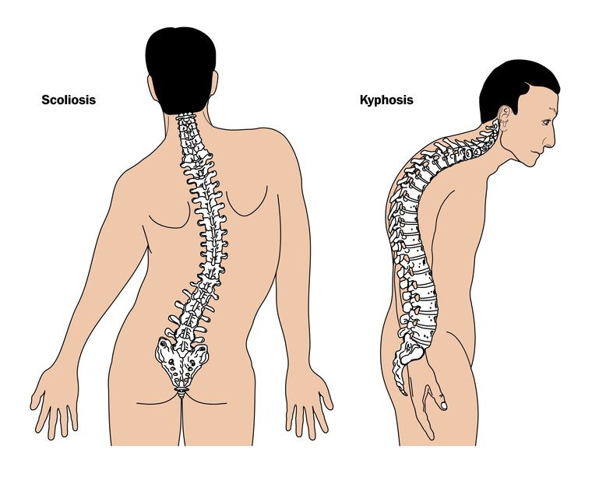
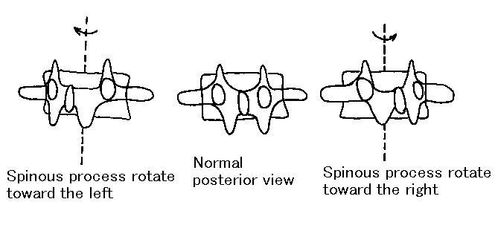
Background - Scoliosis
Scoliosis (A-P)
Kyphosis/lordosis (R-L)
Rotation (S-I)
http://www.spineuniverse.com/sites/default/files/imagecache/gallery-large/wysiwyg_imageupload/3998/2015/06/12/kyphosis_scoliosis14672520_m.jpg
http://www.asahi-net.or.jp/~xf6s-med/pics/erotation.jpg

Slide 3
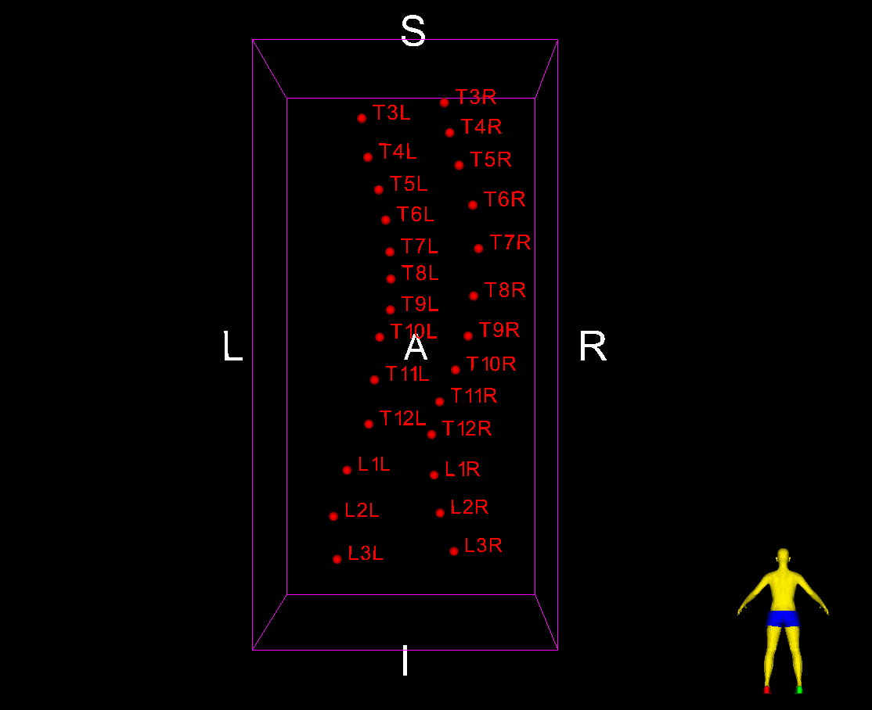
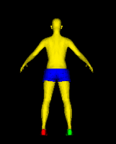
Background – Tracked Ultrasound
Curvature can be quantified using tracked ultrasound
Locate anatomic landmarks and extract the curvature
Cobb angle

Slide 4
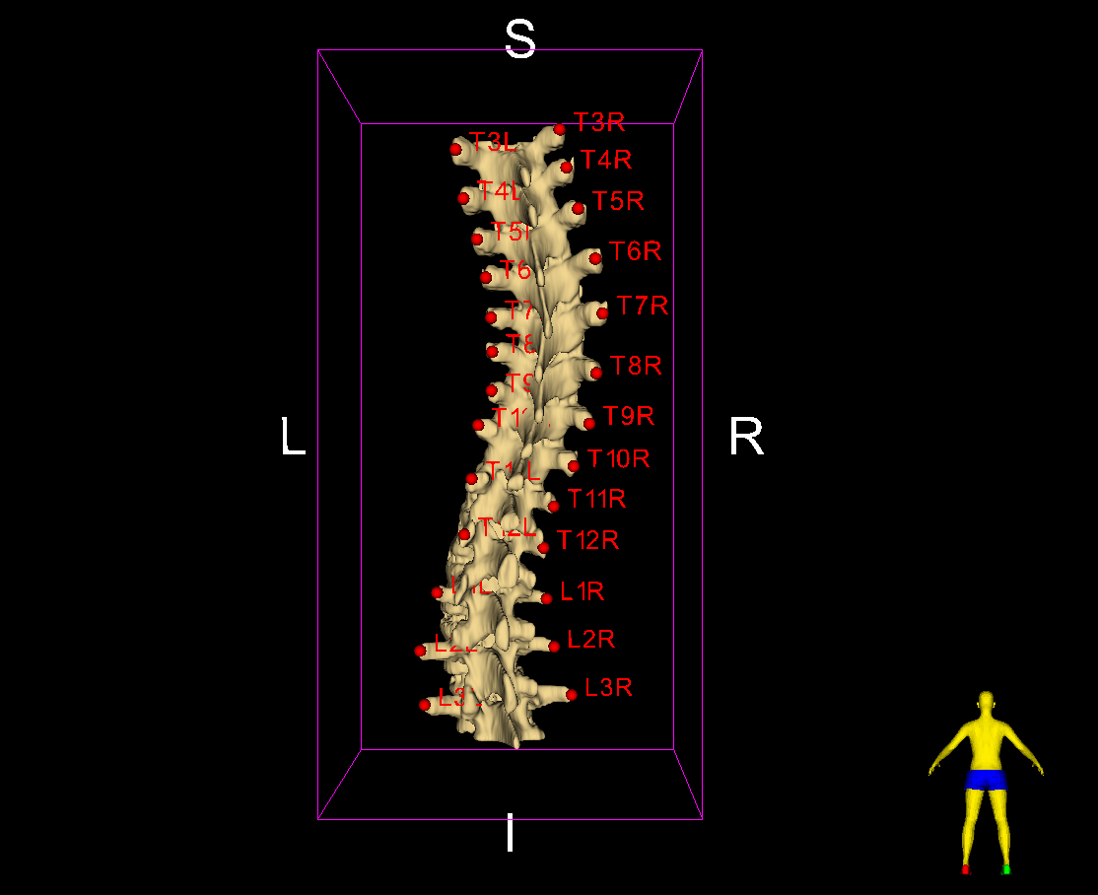
Background - Visualization
One number gives only severity
Multi-modal deformation not conveyed

Slide 5
Background - Registration
Register model landmarks to patient’s
Interpolate resulting transformations
Apply resulting deformation field to model
Z_{P}
Z_{A}
Y_{A}
Y_{P}
X_{P}
X_{A}
S
A
R

Slide 6
Purpose
Visualize spinal anatomy by aligning an average spine model to patient landmarks

Slide 7
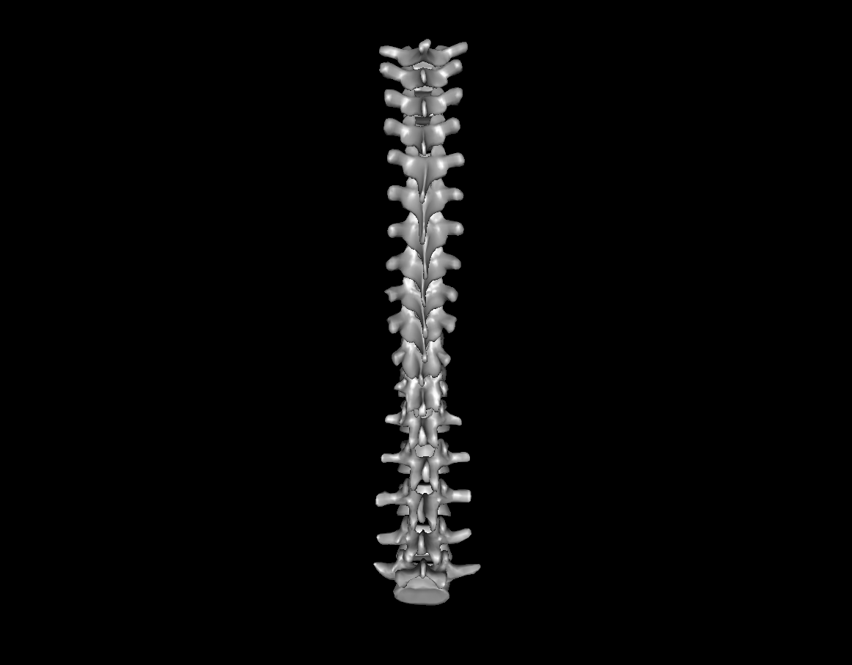
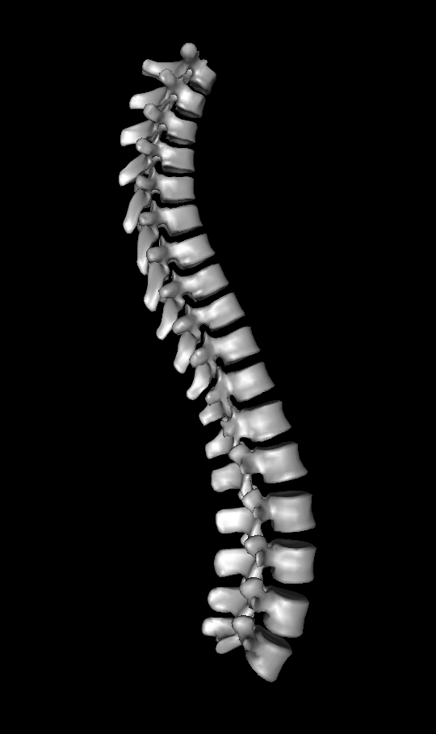
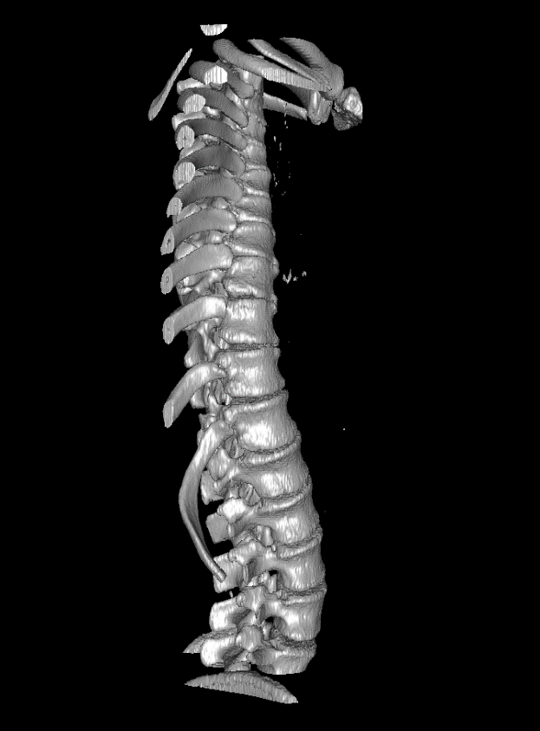
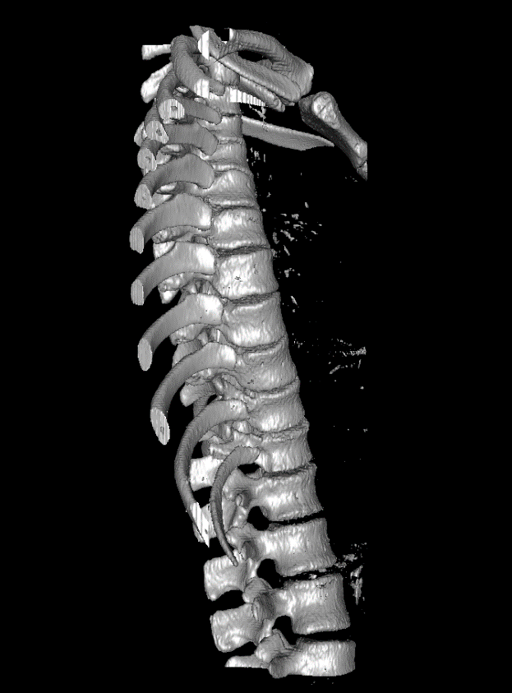
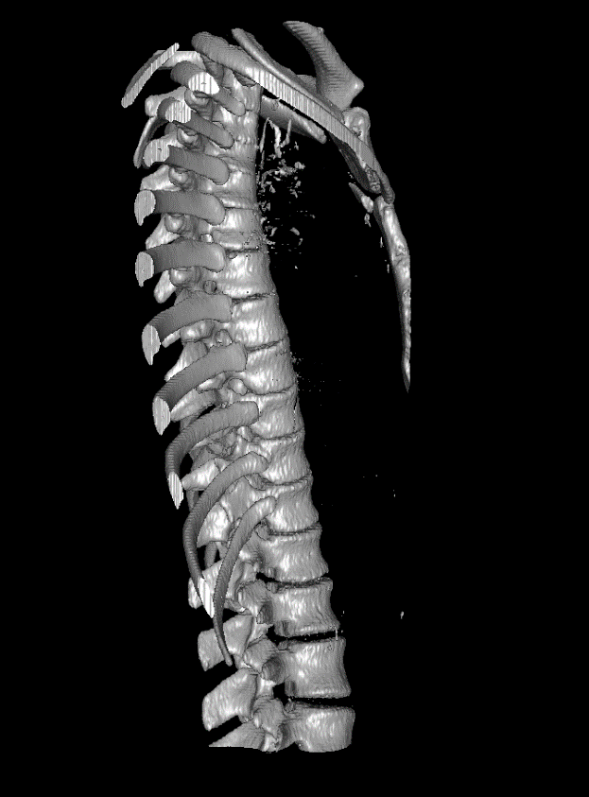
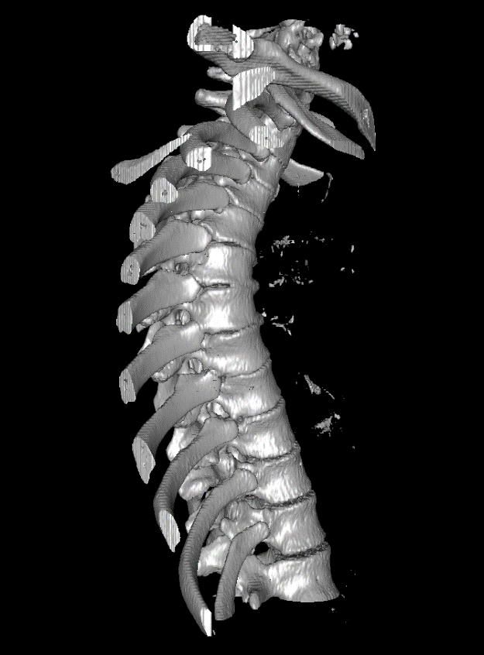
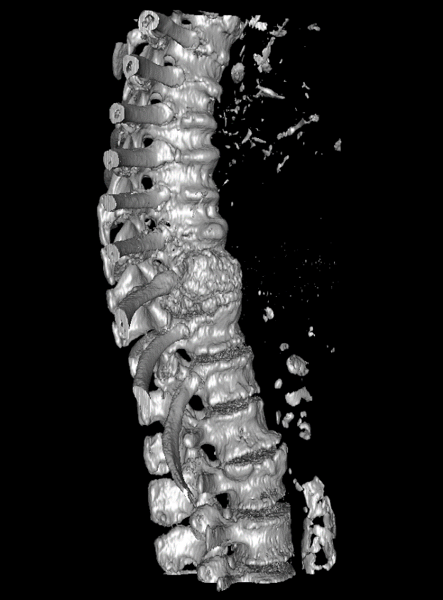
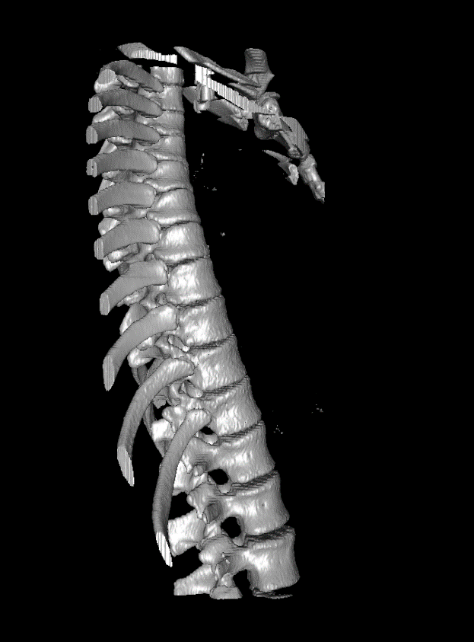
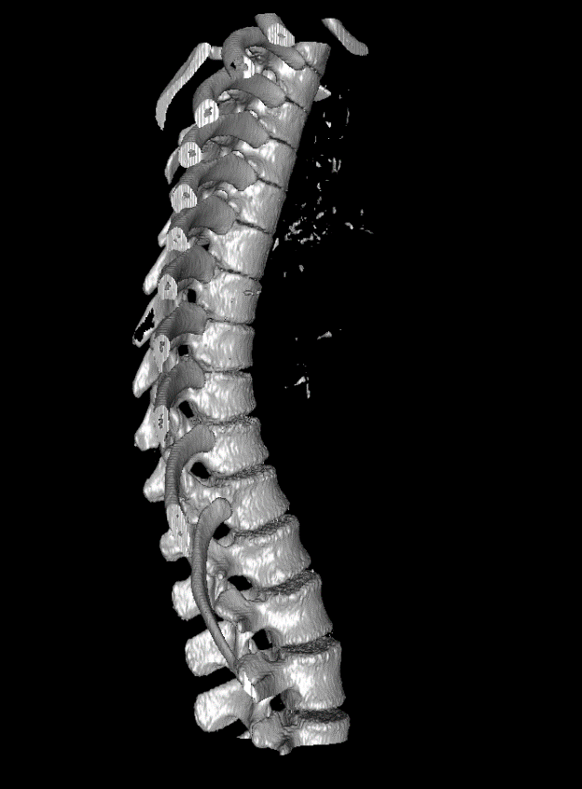
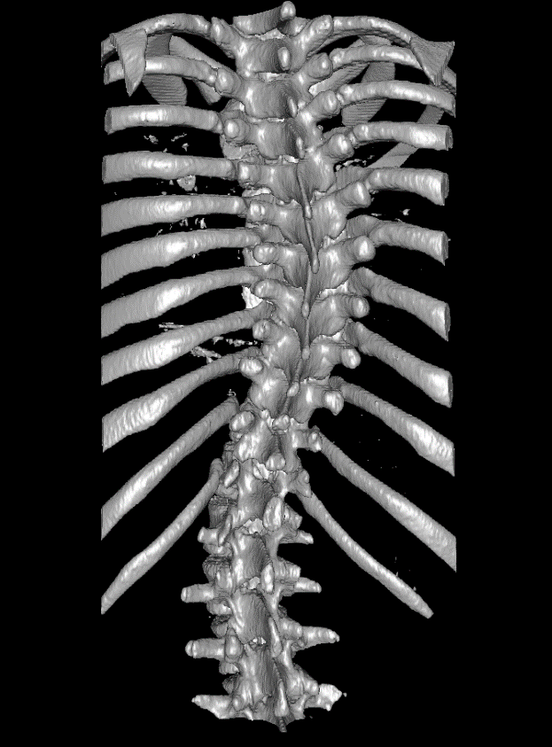
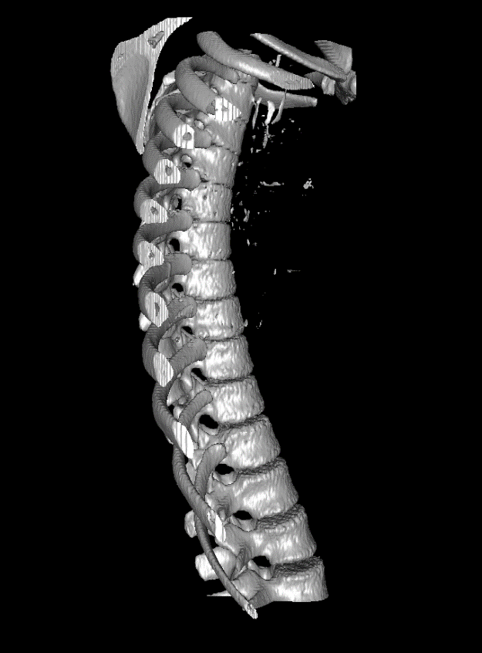
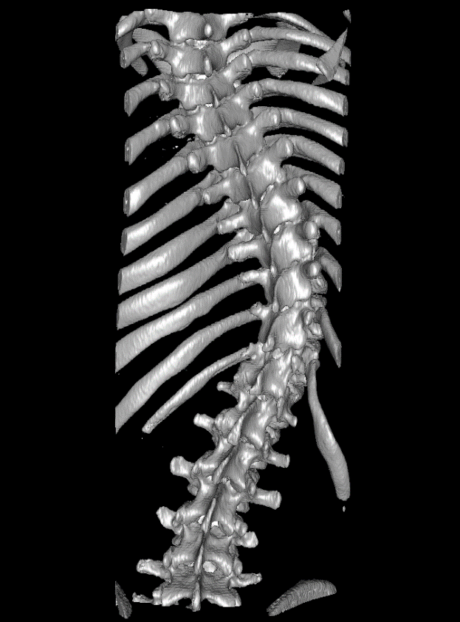
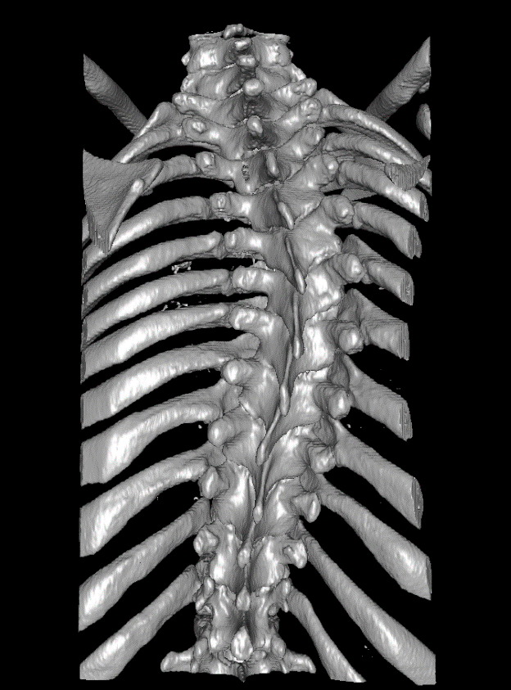
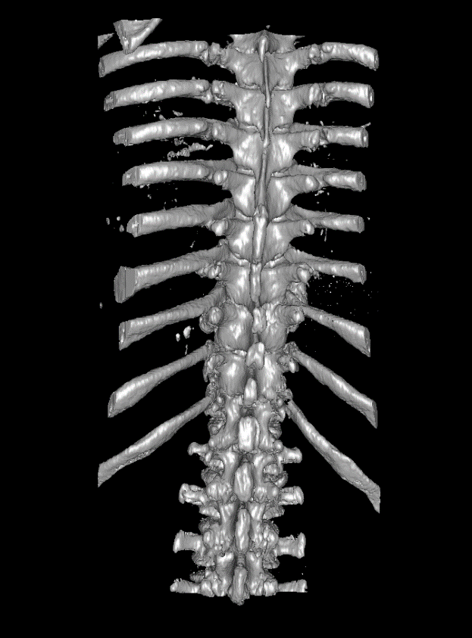
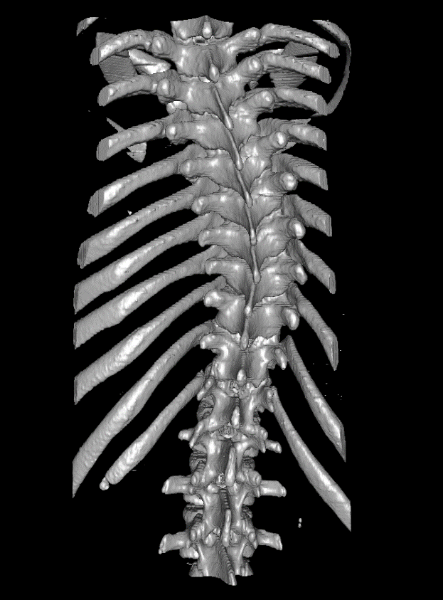
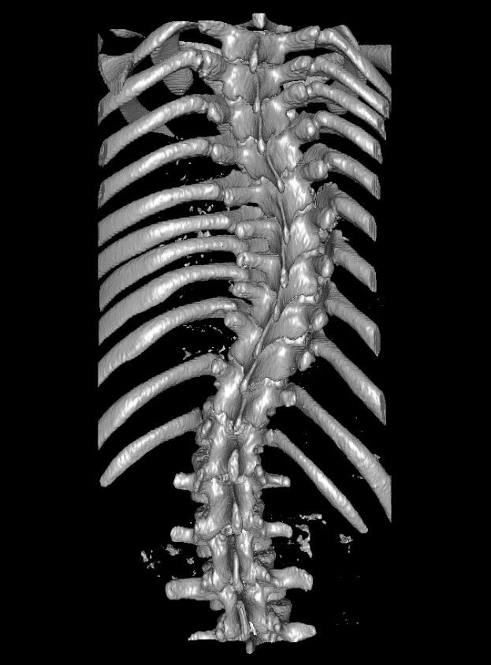
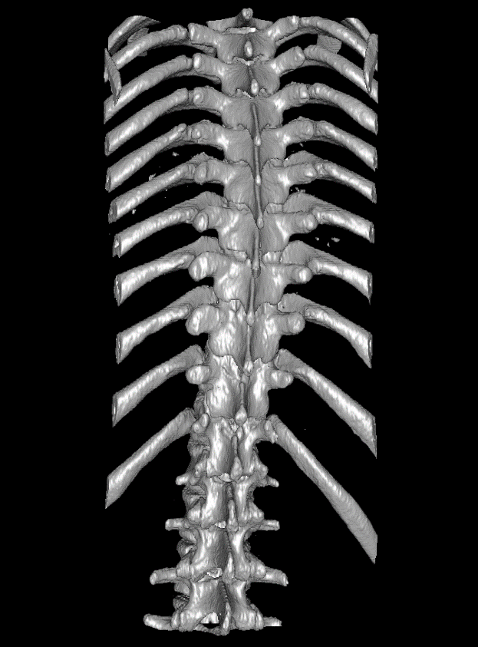
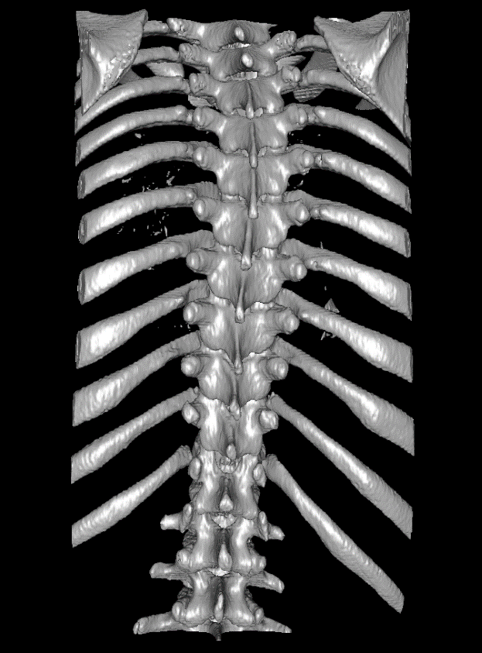
Data
Many spine surface models constructed from patient CT scans
An average model to compare these CTs to

Slide 8
Methods – Landmarks Only
Uses only manually placed landmarks
Accounts for
Transverse process locations
Problems:
Anterior-posterior geometry distortion
Differences in model lengths
S
A
R

Slide 9
Methods – Constant Anterior Offset
Duplicates sets of fiducials at anterior offset
Accounts for:
Model lengths
Anterior-posterior geometry
Problem:
Rotational distortion
S
A
R

Slide 10
Methods – Normal Vector Offset
Duplicates sets of fiducials using vectors normal to spinal curvature
Accounts for:
Model lengths
Anterior-posterior geometry
Rotation
S
A
R

Slide 11
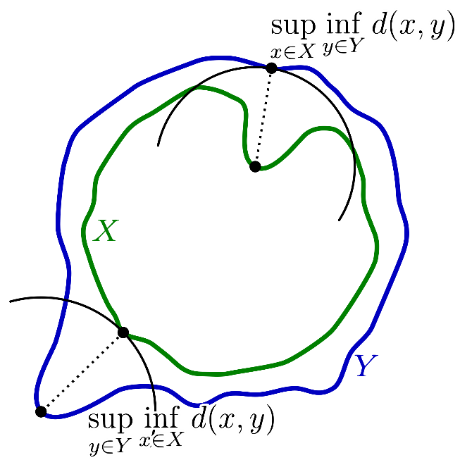
Registration Evaluation Metric
Hausdorff distance
https://upload.wikimedia.org/wikipedia/commons/2/21/Hausdorff_distance_sample.svg

Slide 12
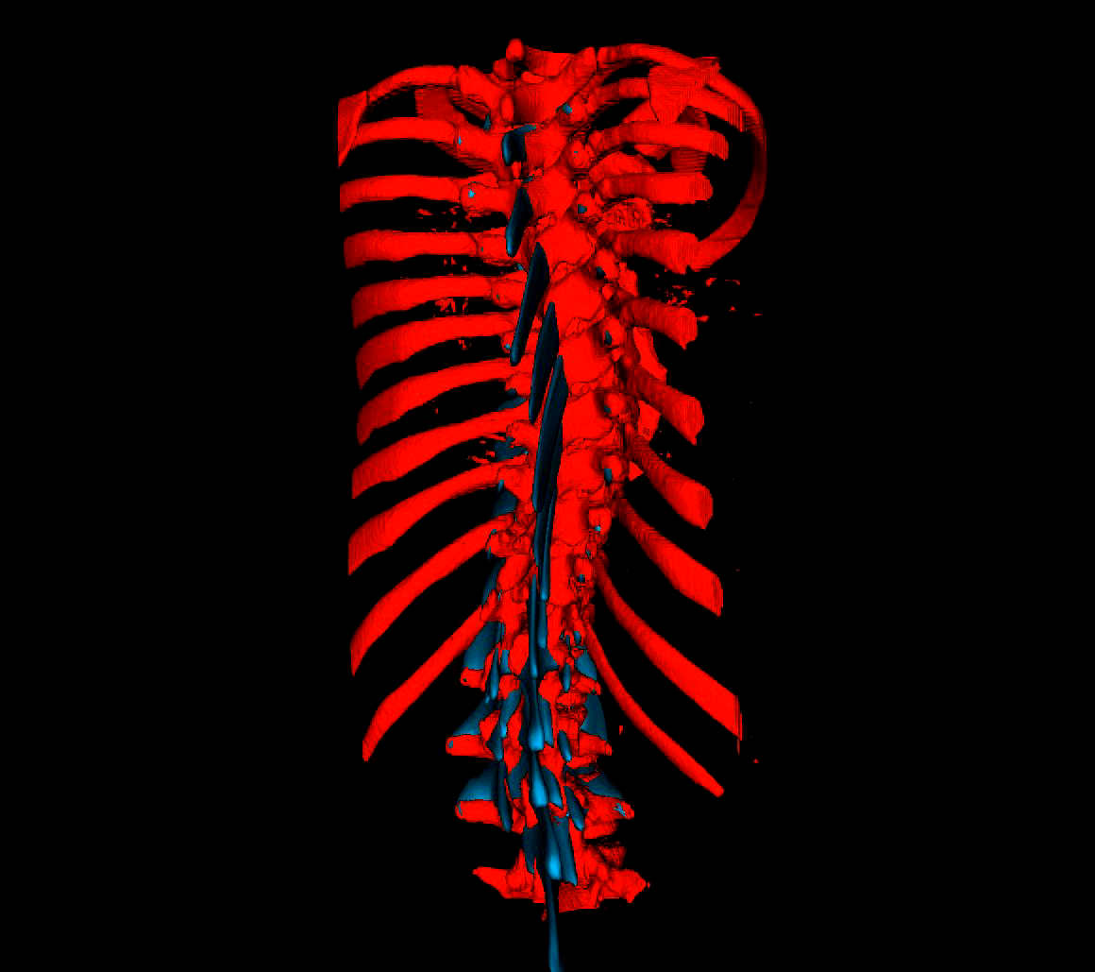
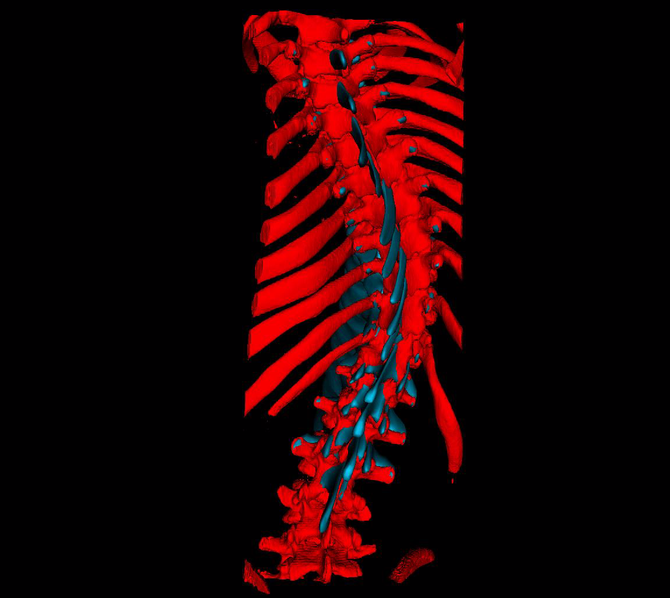
Results – Landmarks Only
Patient 007
Hausdorff Distance | 30.0309
Patient 011
Hausdorff Distance | 30.4773

Slide 13
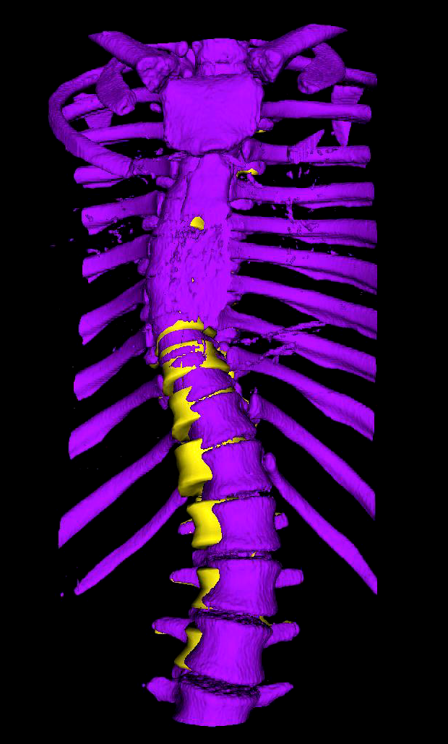
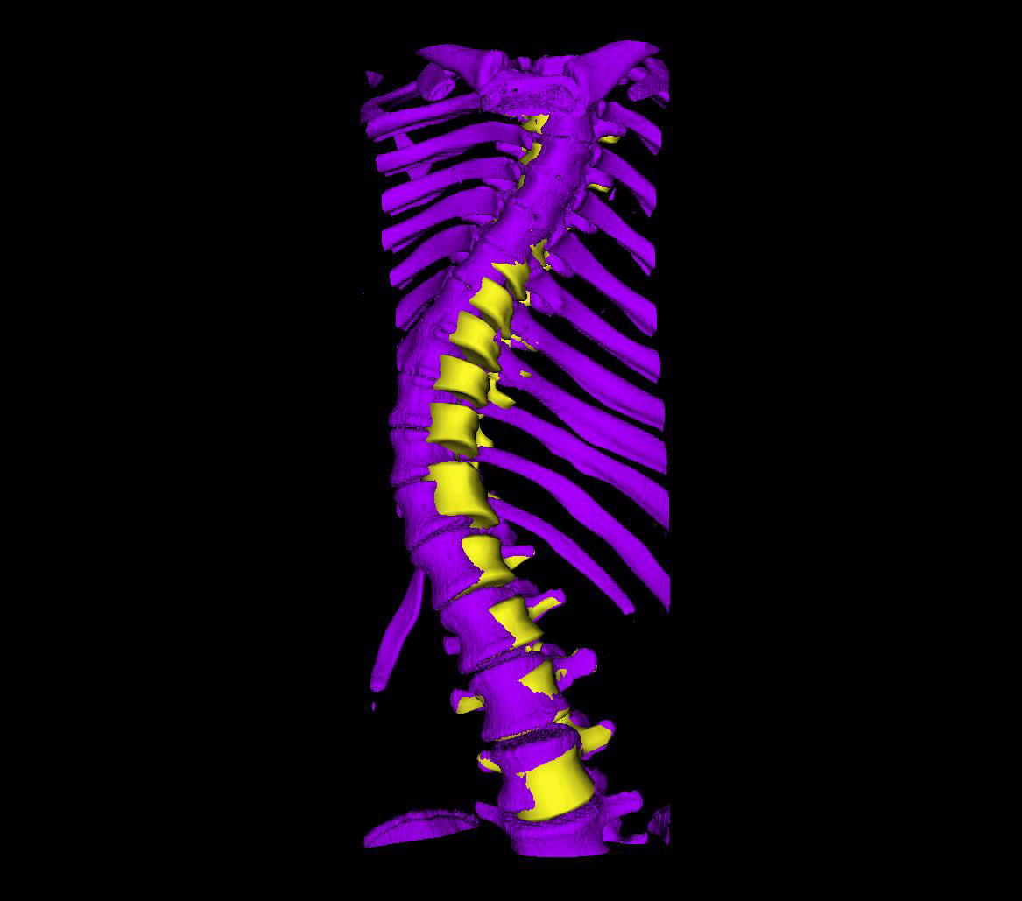
Results – Constant Anterior Offset
Patient 007
Hausdorff Distance | 10.0995
Patient 011
Hausdorff Distance | 6.25646

Slide 14
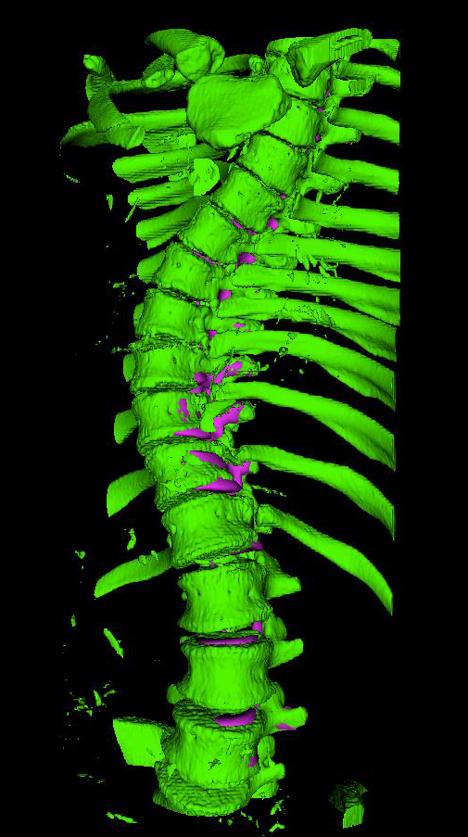
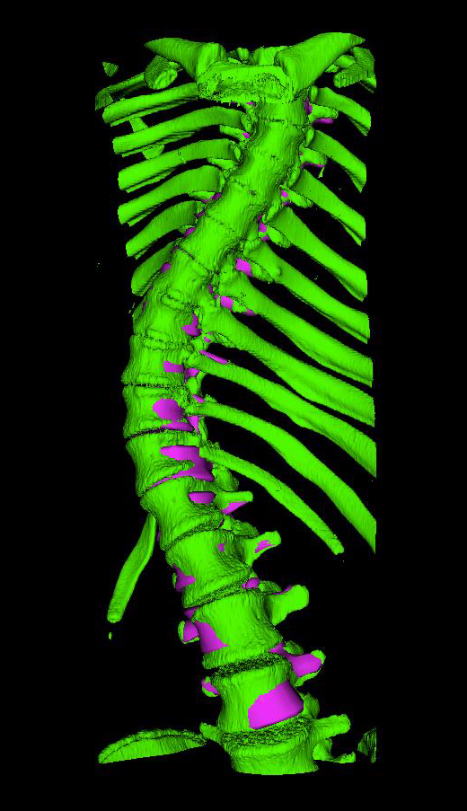
Results – Normal Vector Offset
Patient 007
Hausdorff Distance | 9.85277
Patient 011
Hausdorff Distance | 5.74083

Slide 15
Discussion
Single warped sheet of fiducials is insufficient
Constant anterior offset improves registration by a large margin
Further refinement is possible with normal vectors offset

Slide 16
Next Steps
Use machine learning to discover patterns in landmark locations and use patterns to fill in missing landmarks
Include spinous processes to account for lateral shear deformation?
A
R

Slide 17
Thank you!
Questions?

